Slide 1



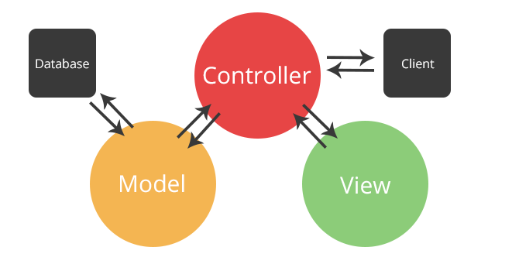
PHP: MVC and Symfony Overview
MVC
PHP & Symfony
SoftUni Team
Technical Trainers
Software University
http://softuni.bg

Slide 2
Contents
MVC
Overview, Purpose
The MVC Pattern
Symfony
What is Symfony?
Annotations
Entities
Views & Controllers

Slide 3
Have a Question?
sli.do #tech-softuni

Slide 4
MVC
Overview, Purpose

Slide 5
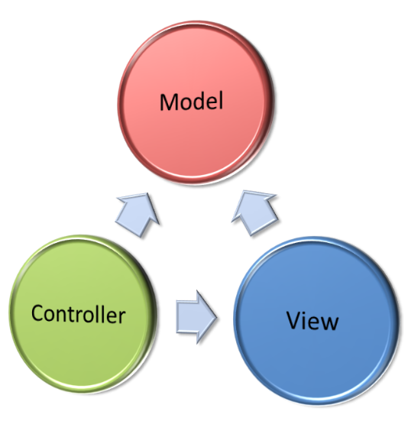
Model-View-Controller - MVC
Model-View-Controller (MVC) is a software architecture pattern
Originally formulated in the late 1970s by Trygve Reenskaug
Code reusability and separation of concerns
Originally developed for desktop
Then adapted for internet applications

Slide 6
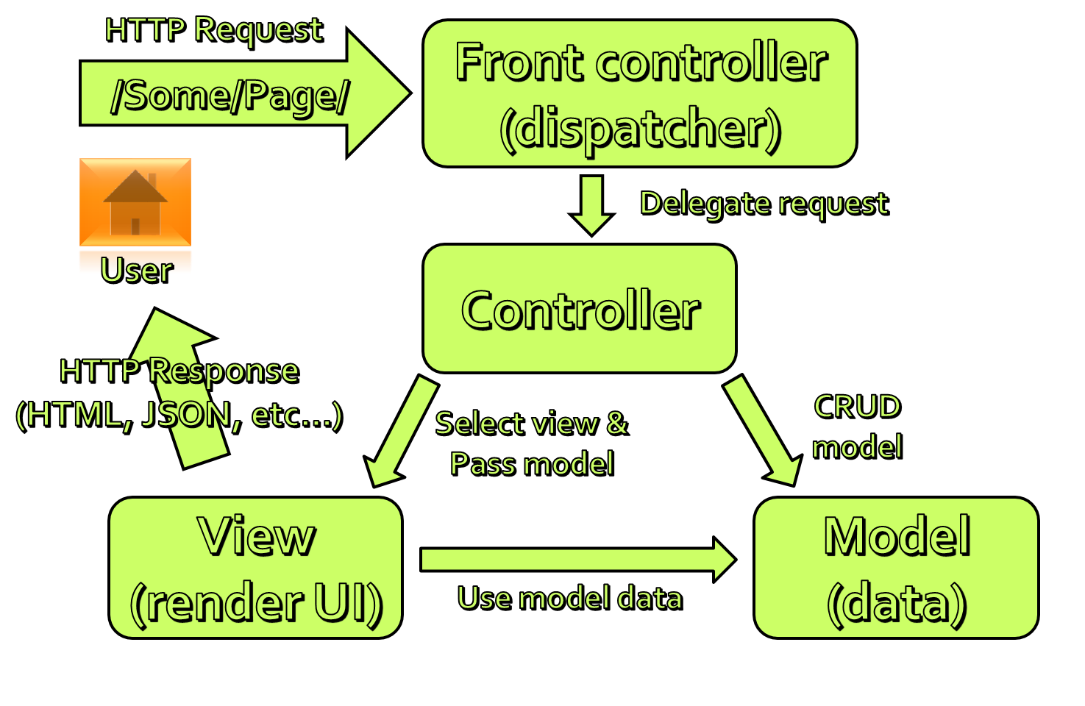
The MVC Pattern
Model-View-Controller

Slide 7

The MVC Pattern
Design pattern with three independent components
Model
Manages data and database logic
View
Presentation layer (renders the UI)
Controller
Implements the application logic
Processes user request, performs an action, updates the data model and invokes a view to render some UI

Slide 8
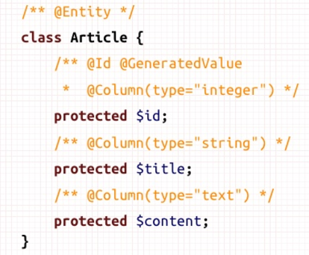
Model
Set of classes that describes the data we are working with
Rules for how the data can be changed and manipulated
May contain data validation rules
Often encapsulates data stored in a database
as well as code used to manipulate the data
Most likely a Data Access Layer of some kind

Slide 9

View
Defines how the application’s user interface (UI) will be displayed
May support master views (layouts)
May support sub-views (partial views or controls)
May use templates to dynamically generate HTML

Slide 10
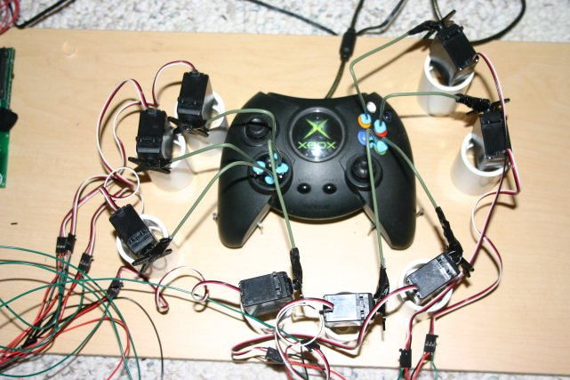
Controller
The core MVC component – holds the logic
Process the requests with the help of views and models
A set of classes that handles
Communication from the user
Overall application flow
Application-specific logic (business logic)
Every controller has one or more "actions"

Slide 11
The MVC Pattern for Web
HTTP Request
/Some/Page/
Front controller (dispatcher)
Delegate request
User
Controller
HTTP Response
CRUD model
Select view & pass data
View
(render UI)
Model (data)
Use model data

Slide 12
MVC Workflow
Incoming request (HTTP request) is routed to a Controller
The Controller
Processes request and creates a View Model
Selects appropriate view
The View Model is passed to View
View transforms the View Model into UI output format (HTML)
The response is rendered (HTTP response)

Slide 13




Example: Forum
Route (access URL)
PostController
Create($title, $content)
Adds a forum post to the database
Edit($postId)
Gets post with id $postId and alters the title and content in DB
Delete($postId)
Finds post by id $postId and deletes it from the DB
View($postId)
Gets post with id $postId and displays it to the user

Slide 14


Example: Forum (2)
UserController
Register($username, $password)
Adds a user to the database
Login($username, $password)
Checks if user exists and if $password matches the one in the database (after encryption)

Slide 15

Symfony
Web MVC Framework for PHP

Slide 16
What is Symfony?
Web MVC framework for PHP
Created by Sensio Labs
Works with many database types (MySQL, SQLite, MSSQL, etc..)
Entity creation with Doctrine
Defining data models and their properties
Scaffolding
Code generation tools (less manual typing)
Generates data models + DB tables (by using Doctrine)

Slide 17
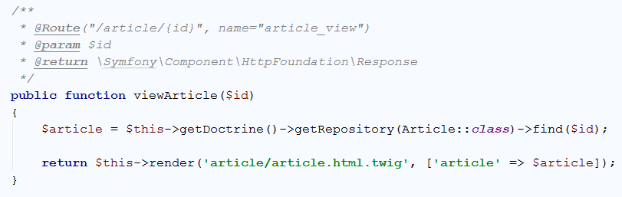
Doctrine Annotations
Comments, which give Symfony context about the code below them
URL that calls the controller action
Action name
Action Parameters
Return type
Describes this action

Slide 18
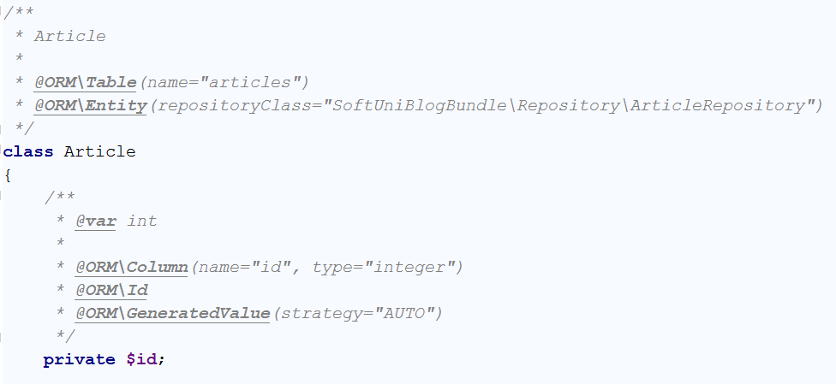
Doctrine Entities
Models (classes), which describe the objects, stored in the DB
Database table name
Class name
Field Data Type
Field name
Column in the database table

Slide 19
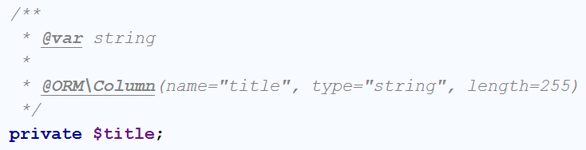
Symfony Entities: Fields
Entities have fields and properties like in C#
Use annotations for additional functionality
Tell the database what column names and types to use
Data type
Table column name
Table column type
Field name
Table column max length

Slide 20
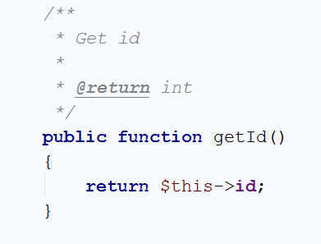
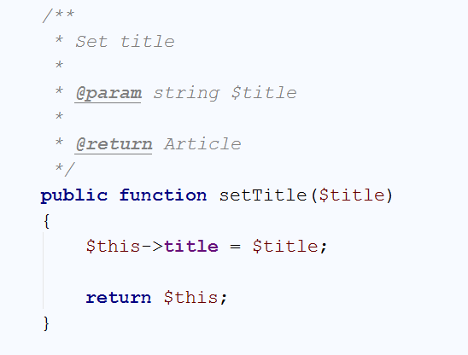
Symfony Entities: Properties
Getters and Setters like in C#
Parameter data type
Return data type
Return data type
Function name
Function name
Accessing the field
Set title
Return the object

Slide 21
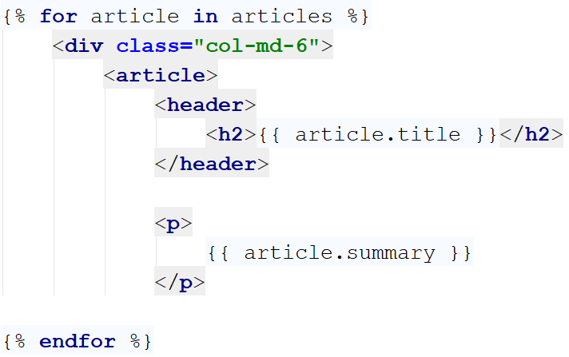
Symfony Views
Using the Twig view engine
HTML with dynamic Twig syntax:
Twig foreach
Twig syntax
HTML Code
Twig syntax

Slide 22
Symfony Controllers
Functions, which the user calls by accessing the specific route
Controller action route
Action name
Action Parameters
Return type
Controller action

Slide 23
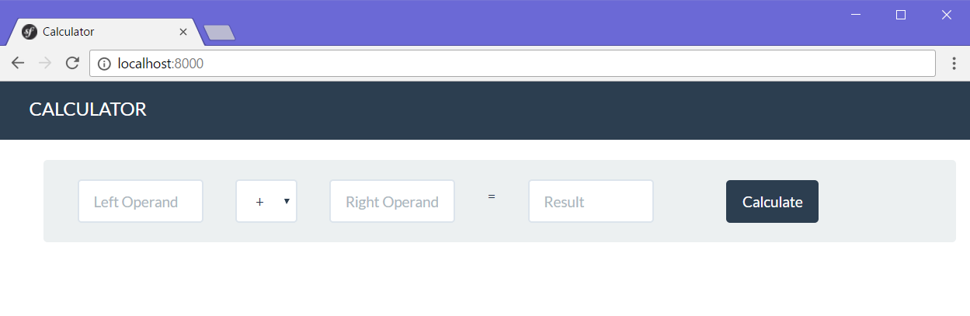
Problem: Simple Calculator Web Application
Write a web application, which can calculate the result between two operands
Implement addition, subtraction, multiplication and division

Slide 24

Web application with Symfony
Live Exercises in Class (Lab)

Slide 25

Summary
MVC
Versatile design pattern
Runs most of the Web
Code is organized into Models, Views and Controllers
Symfony
Web MVC framework for PHP
Establishes communication between the user, web application and the database

Slide 26







PHP: MVC and Symfony Overview
https://softuni.bg/courses/software-technologies

Slide 27
License
This course (slides, examples, demos, videos, homework, etc.) is licensed under the "Creative Commons Attribution-NonCommercial-ShareAlike 4.0 International" license

Slide 28





Trainings @ Software University
Software University Foundation – softuni.org
Software University – High-Quality Education, Profession and Job for Software Developers
softuni.bg
Software University @ Facebook
facebook.com/SoftwareUniversity
Software University Forums – forum.softuni.bg

